Slide 1
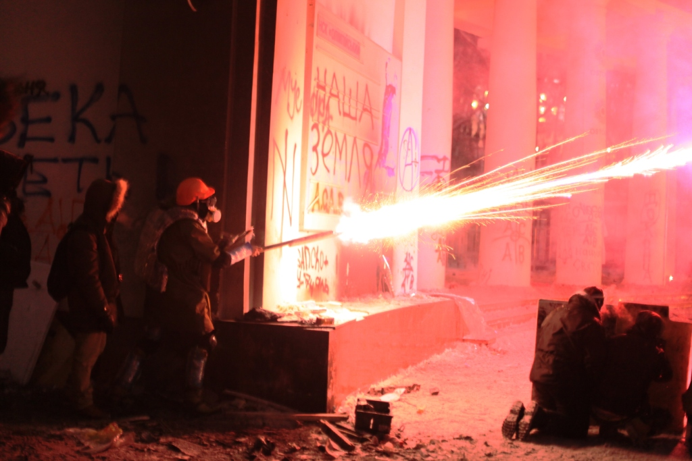
Ukrainian experience of fighting high level corruption (2014-2018)
Andrei Marusov
Transparency International Ukraine

Slide 2
National Anticorruption Bureau of Ukraine
Investigating grand corruption of Viktor Yanukovych
Strengthening integrity of public officials (asset declarations system)
Control over income & expenditure of political parties
Cutting down sources of corrupt flows: public procurement, sale & lease of state \ municipal property; final beneficiaries etc.
Challenges and problems
Key anticorruption drivers \ catalysts…

Slide 3
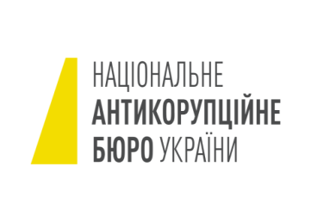
National Anticorruption Bureau of Ukraine (1)
Special law enforcement body investigating “elite corruption”.
Independent status. Open recruitment. Budgetary guarantees.
Created from zero. Civic oversight. Operational since 2016.
Specialized Anticorruption Prosecutor’s Office (SAPO)
Prosecutor control over NABU investigations.
Independent status (its head is the Deputy General Prosecutor). Open recruitment. Created from zero. Operational since 2016.

Slide 4
National Anticorruption Bureau of Ukraine (2)
NABU results: almost 150 cases in courts (by 01.07.18); 227 people accused (among them – 20% managers of state enterprises; 20% judges & prosecutors; several Members of Parliament…).
Approximately 10 mln USD recovered voluntarily, 2 mln USD upon court decision…
Problem: Only one fifth of cases received court decision; no court consideration started – in half of cases submitted! Court sabotage; lack of judges etc. Solution – High Anticorruption Court
Problem: SAPO fell under political control….

Slide 5
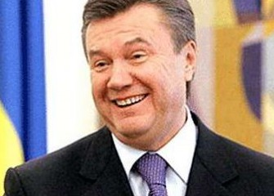
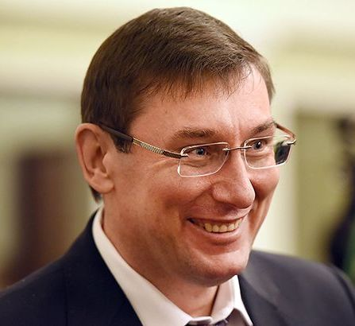
Investigating grand corruption of Viktor Yanukovych
No criminal conviction of Yanukovych or his allies on corruption accusations (responsibility of General Prosecutor’s Office)
Very dubious confiscation of allegedly Yanukovych’s 1,5 bln USD
‘Failure’ or ‘Selling out’ the investigation!?

Slide 6
Strengthening integrity of public officials
Introduction of the comprehensive system of public officials’ asset declarations – since 2016 (https://public.nazk.gov.ua/)
Any public official and close relatives – from the lowest rank to the President of Ukraine
Wide scope: monetary income; property; companies owned etc. etc.
Clear responsibility for violations (National Agency for Corruption Prevention, NACP – administrative penalties, NABU – criminal investigations)
Illegal enrichment – criminal crime, to be investigated by NABU.
NABU: 54 illegal enrichment cases investigated.
NACP: failure to launch automatic control of declarations; fell under political control….

Slide 7
Control over income \ expenditure of political parties
All parliamentary parties receive income from the state budget
All parties must regularly report about their income \ expenditure (reports available online)
(Almost) no donations from legal entities allowed
Administrative and even criminal liability for violations
Who’s in charge? National Agency for Corruption Prevention.. ☹

Slide 8
Source of political corruption – electoral system…
Half of Verkhovna Rada elected on nationwide party proportional list. Another half – on “majority system”…
Widespread ‘buying of votes’ by ‘majority candidates’…
Attempts to introduce purely proportional system – stalled by ruling political coalition…

Slide 9
Cutting down sources of corrupt flows…
“In Ukraine we’ve got the most transparent corruption in the world!”
Public procurement system proZorro: everybody sees everything!
  Online platform for civic oversight DoZorro
proZorro.Sale: moving towards open and transparent disposal of the state \ municipal property (sale, lease…). Privatization
  Open online auctions to sell licenses for exploitation of natural resources (recent governmental decree)
Obligatory disclosure of final beneficiaries. Key state databases \ registers available online free of charge…

Slide 10
Challenges \ problems
2014-2015 – Windows of opportunity wide open
2016 – Corruption Restauration (blocking any further anticorruption reform)
2016 onwards – Corruption Counterrevolution:
  Anticorruption activists obliged to publish their assets
  Assaults on civic activists in regions, one activist killed in Kherson
  Persistent attempts to dismantle the asset declarations system, proZorro; cut the powers of NABU, to put the SAPO, NACP under full political control…

Slide 11
Key anticorruption drivers \ catalysts
Civil society (2014-2015; growing disillusionment)
International community
  EU – Visa Liberalization Plan (asset declarations system)
  IMF, WB, USA – introduction of NABU, High Anticorruption Court
Reformers in the government \ parliament (just a few anticorruption bastions left…)
Rise of local communities with advancing decentralization…

Slide 12
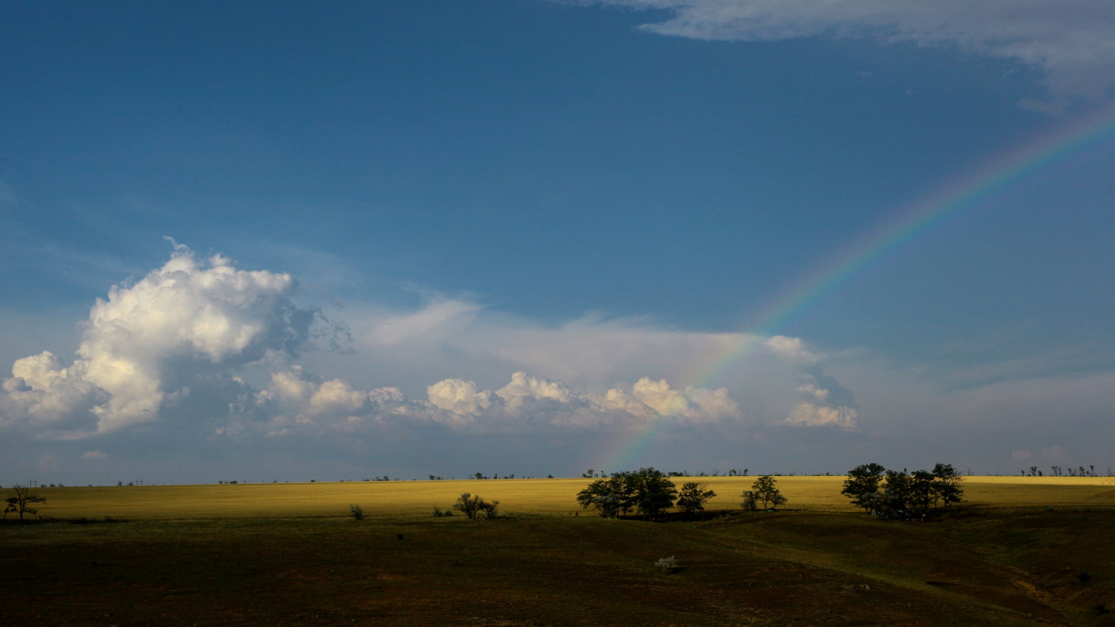

Key factors of success (and lessons for TI chapters):
Your previous expertise \ experience does matter a lot!
Your reputation is of paramount importance!
Jump into the window of opportunity!
Do take risks!
Identify and cooperate with reform leaders in the government and the parliament
The golden triangle “government-business-civil society” is the key factor of sustainability
Make partnerships and coalitions with civil society organizations in the country and move your joint agenda into the governmental lobbies Register.
Thank you!
Andrei Marusov
marusov72@gmail.com
Transparency International Ukraine
www.ti-ukraine.org

